Slide 1
Complaint Redressal System
Domain : Telecom

Slide 2
Team members
RAHUL
PREMNATH
SUREKHA
VISHNUDEVI
FRONTEND
REKHA
PRATHMESH
PRASAD
SAIKUMAR
PRATIKSHA
BACKEND

Slide 3
Contents
Objectives
Introduction
Tools Used
Scope
Class Diagram
Use case Diagram
ER Diagram
Tasks Performed
Advantages
Screenshots Output
Conclusion

Slide 4
Objectives
The objective of the complaints management system is to make complaints easier to coordinate, monitor, track and resolve, and to provide company with an effective tool to identify and target problem areas, monitor complaints handling performance and make business improvements.
Online Complaint Management is a management technique for assessing, analyzing and responding to customer complaints. Complaints management software is used to record , resolve and respond to customer complaints, requests as well as facilitate any other feedback.

Slide 5
Introduction
ABC Telecom Ltd is one of major communication service providers offering landline , mobile phone etc. service.
They want to have an online complaint management system where the customers can raise complaints regarding their services.
It allows customers to login and raise ticket above their not satisfaction with the organization. It allows organizations to obtain feedback on how to improve their services and to solve the problems with the customer base.
So we developed This application is used to store the data of complaint raised by customers where we can add, update , delete by using CRUD operation.

Slide 6
Tools used
Front end : Angular
SERVER SIDE: Spring Boot
BACK END: MYSQL Hibernate

Slide 7
Scope
The system is a web-based application, developed using spring boot framework and , MYSQL as a backend and angular as a front-end that performs the following functions:
Enables the Administrator to create and manages the lifecycle of different types of users
Customer
Manager
Engineer

Slide 8
Scope
Enables the Customers to login to the portal to raise and track complaints related to the services availed by them
Enables the Manager to login, view the complaints raised by the customers and assign the ticket to the engineers based on the PIN Code
Enables the Engineers to pick up the tickets, work on them, enter the status of the
task. They can also re-assign it to the Field Workers if they cannot resolve it from
the data center.

Slide 9
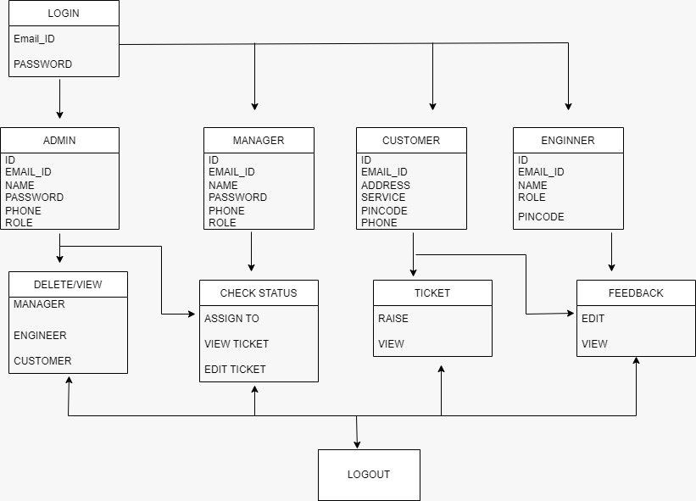
Class Diagram

Slide 10
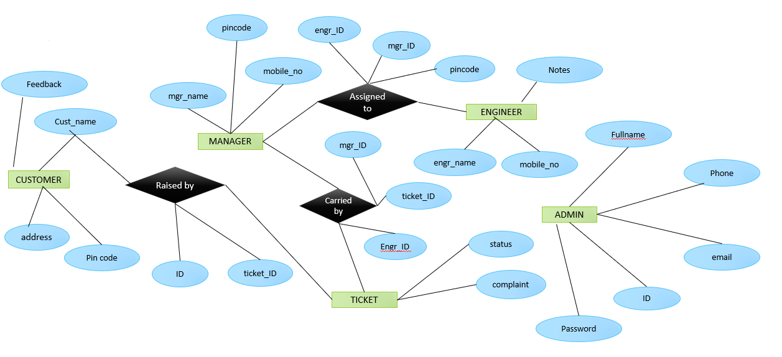
ER diagram

Slide 11
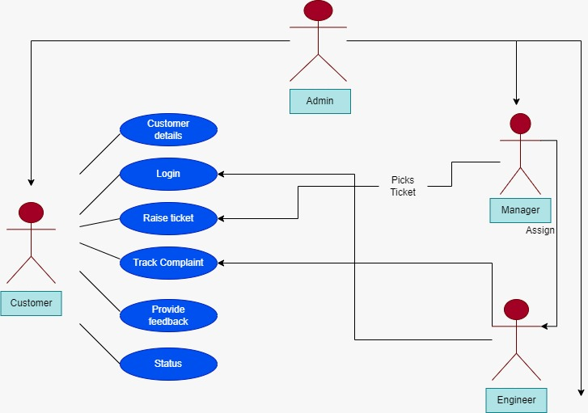
Use case diagram

Slide 12
Tasks Performed By Admin
Admin user is the super user of the system. The admin user creates other categories of user like customer, manager, and engineers.
The admin user has the privilege to create, update and delete the records through the web interface and can access the entire system.

Slide 13
Tasks Performed by Customer
Customer users can perform tasks like creating a complaint, view complaints, tracking the complaint and providing feedback on the resolution of the complaint through the web UI. The feedback provision is an optional feature. Customers provide the following minimal details such as name, address (with PIN Code), telephone / mobile number, type of problem (cannot make a call, but receive a call or can make calls, but cannot receive calls, or neither make nor receive calls).
Once successfully submit the complaint, a ticket is raised and shared it with the customer. At that time, the status of the ticket will be ‘RAISED’

Slide 14
Tasks Performed by Manager
Managers can pick the tickets from the active ticket list and assign them to the engineers based on the PIN code of the customer (where the service is installed).
There are different managers to take care of different PIN codes. Managers can able to see the status of all the tickets in all the areas.

Slide 15
Tasks Performed by Engineer
Engineers can log in and view all the tickets assigned to him/her and can pick the tickets assigned to them and assign it the status of ‘WIP”, (work on the case, which is dependent on the type of problem and resolve) and update the status as ‘RESOLVED’.
In case they are not able to resolve the issue at their end, they can remark that this needs to be reassigned to Field Workers in case of a cable fault or at the customers’ site, and flag it as ‘ESCALATED”

Slide 16
Advantages
Fast responses and tracking of complaints are useful for the customers to know their status. This reduces the waiting time of the customers to reach customer care.
The complaints will be redirected or assigned to the respective engineers by matching the customer’s and engineer’s pin code which is easy and flexible to use.
In future we can improve this application by adding more benefits to customers in order to solve the issues faced by them.

Slide 17
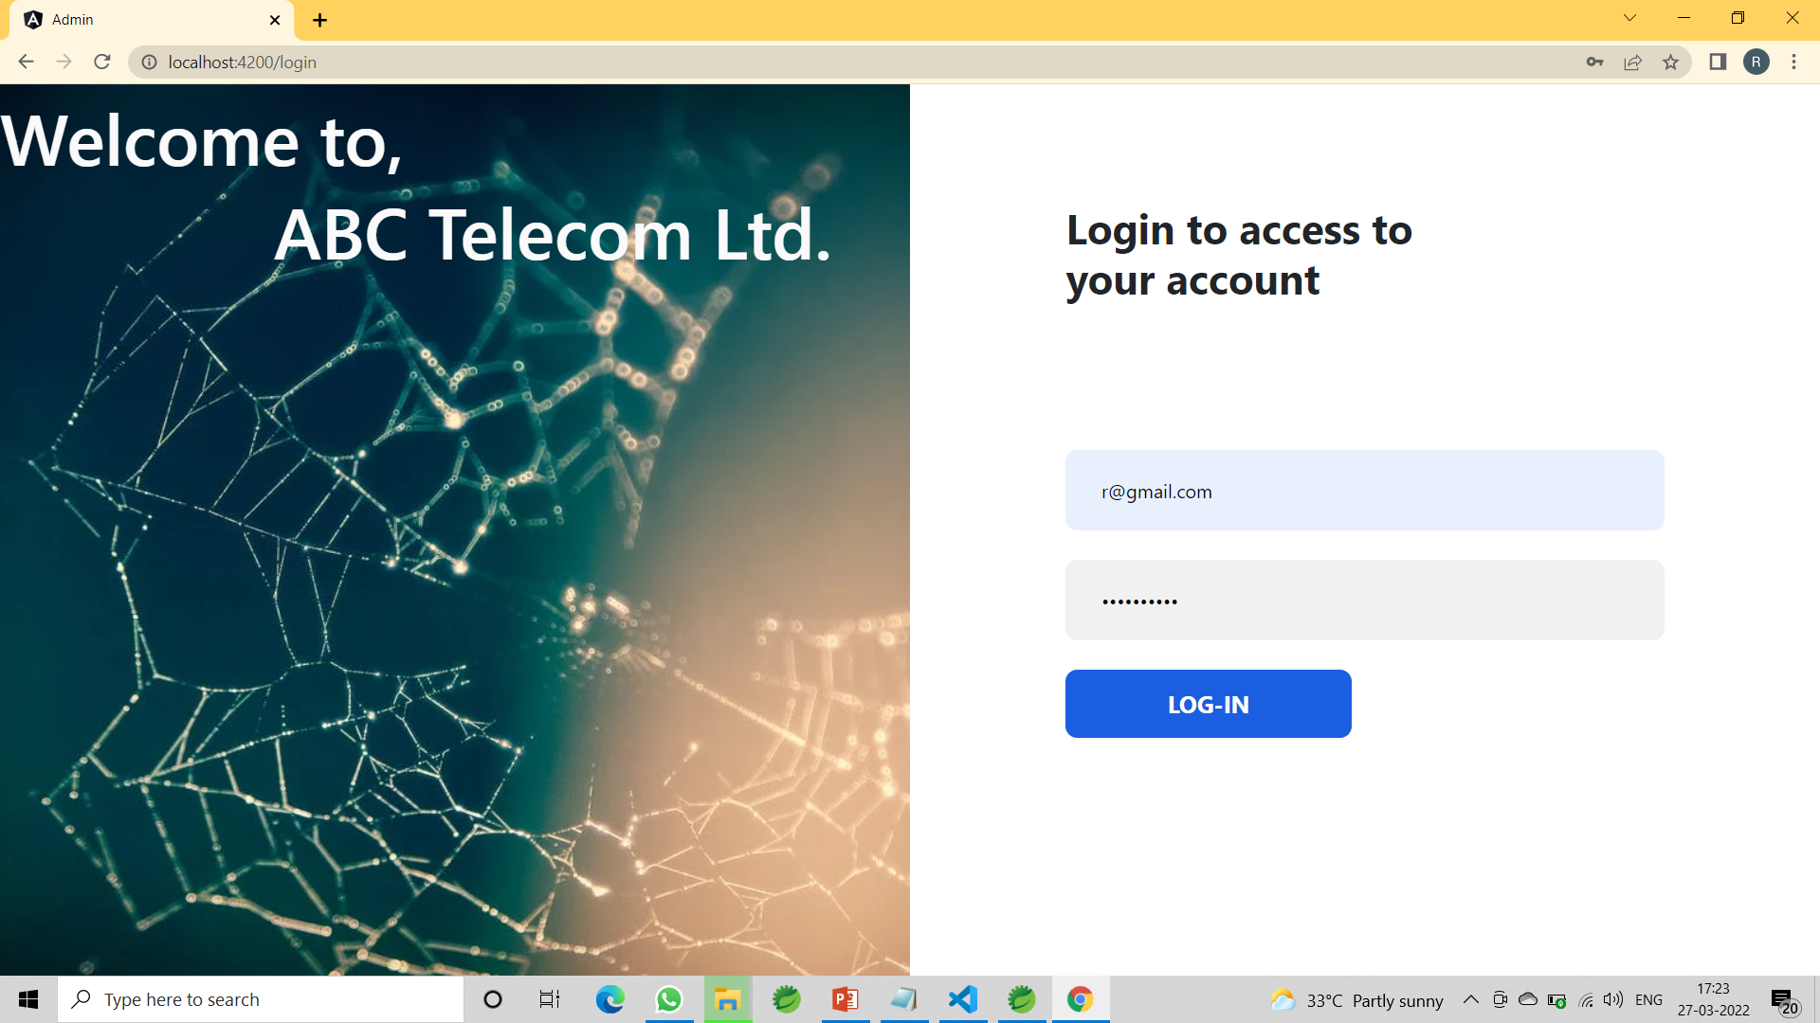
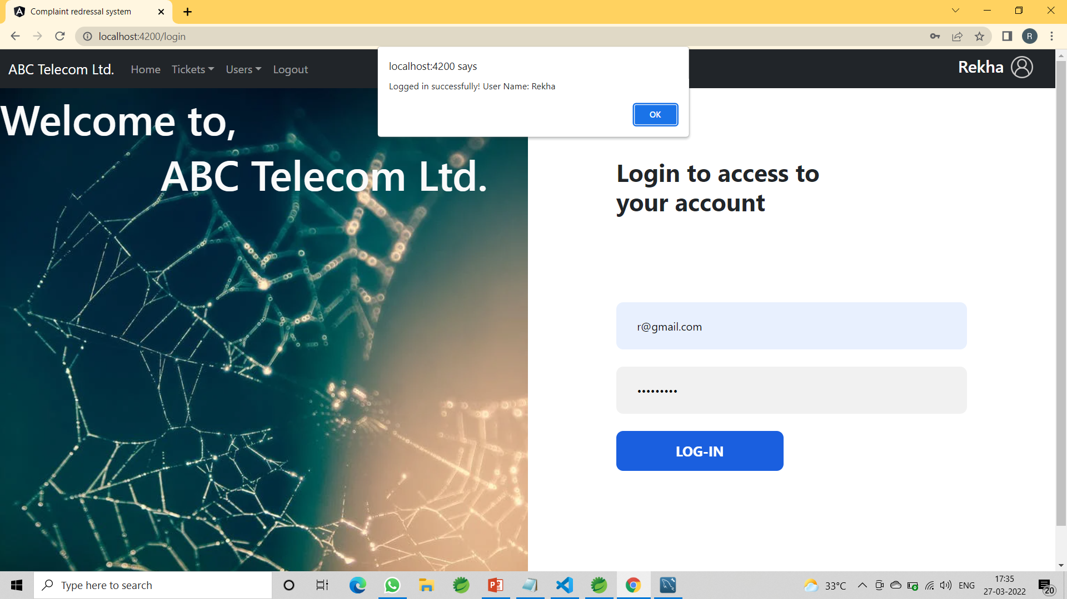
Output screenshots

Slide 18
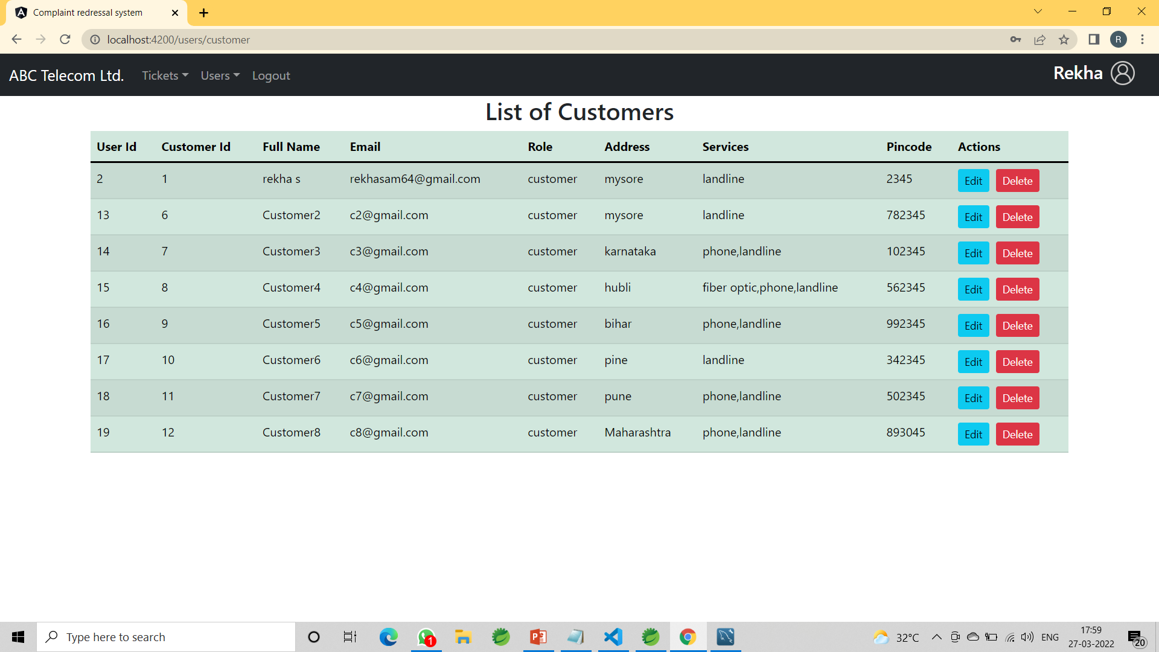
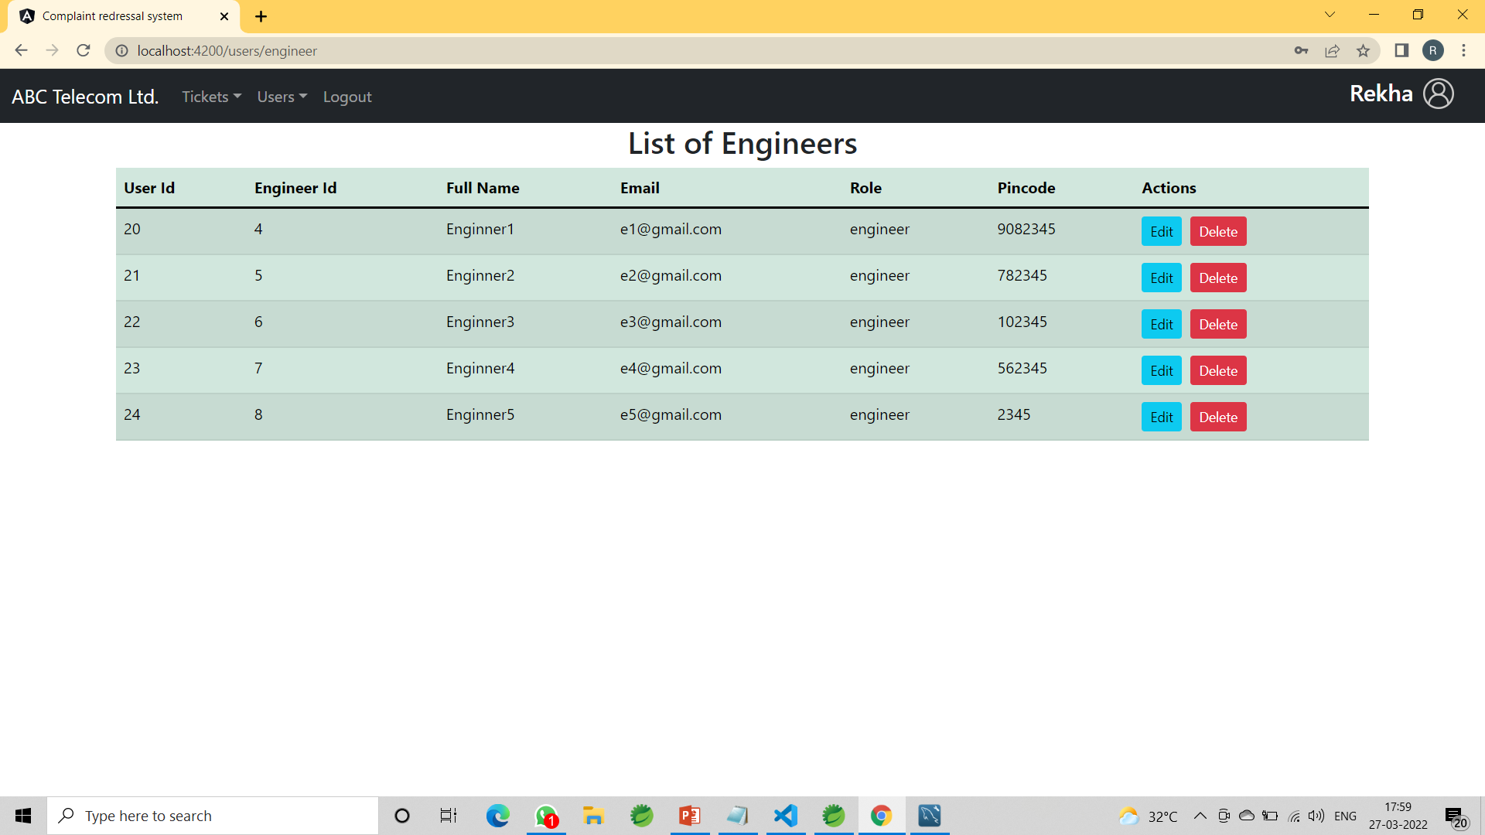
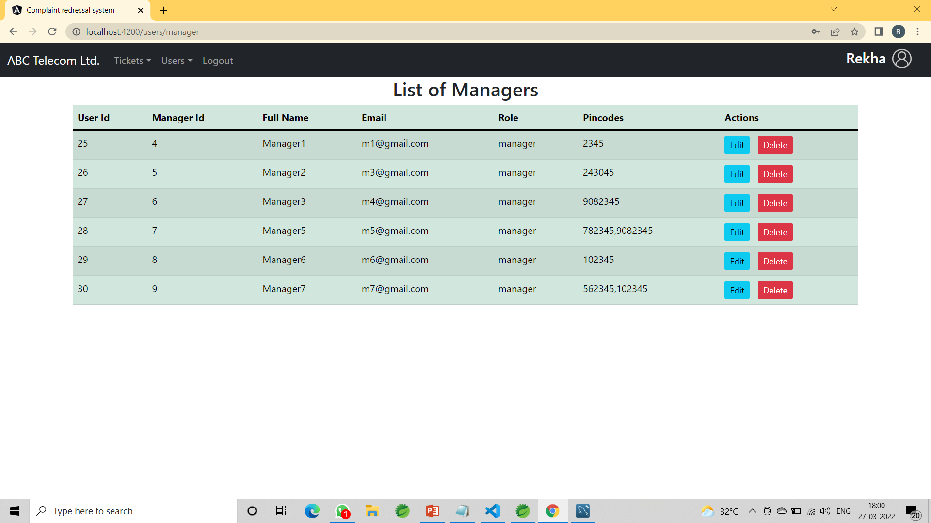
Admin can access the Customer , Manager and Engineer

Slide 19
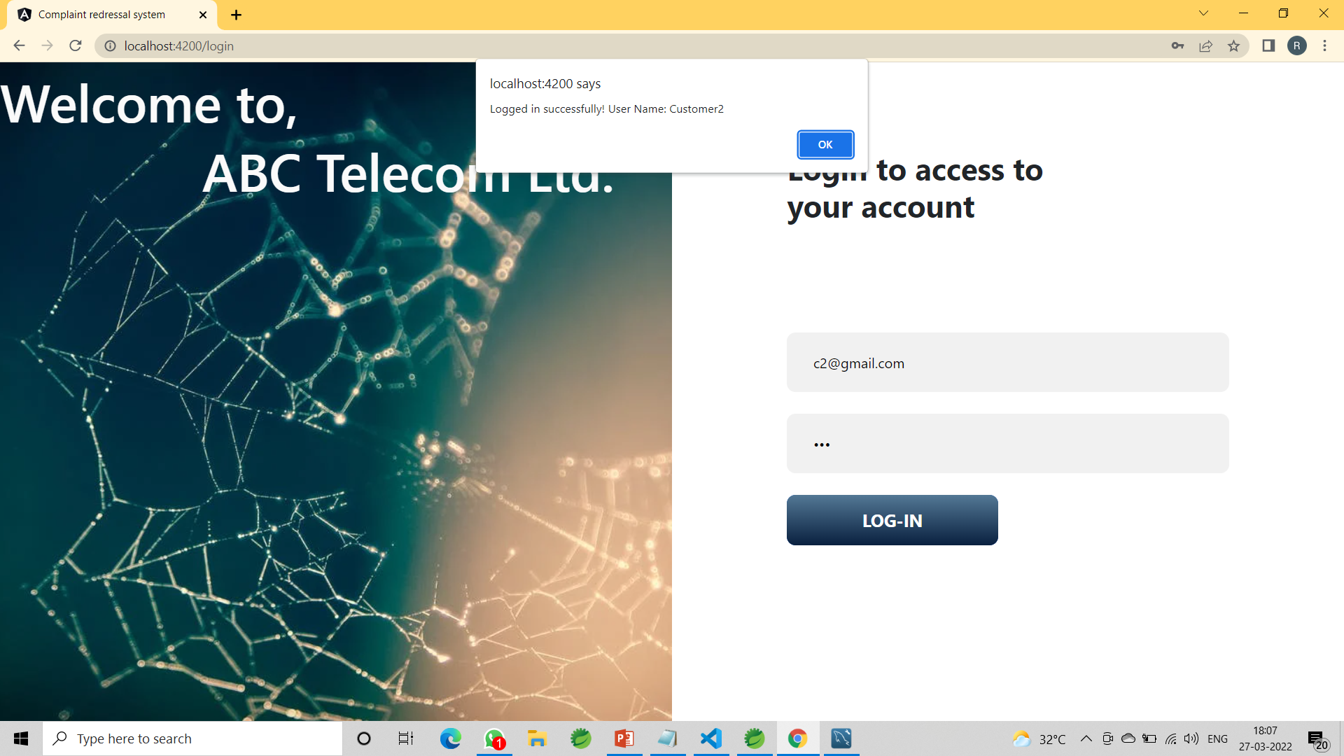
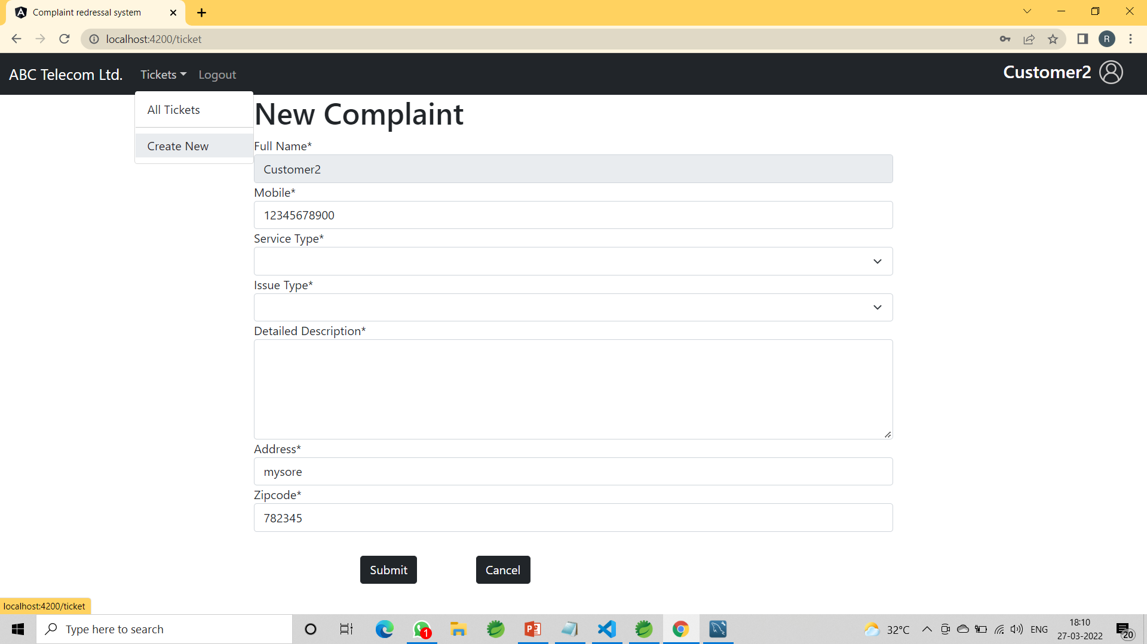
Customer can see the list of ticket and also raise the ticket

Slide 20

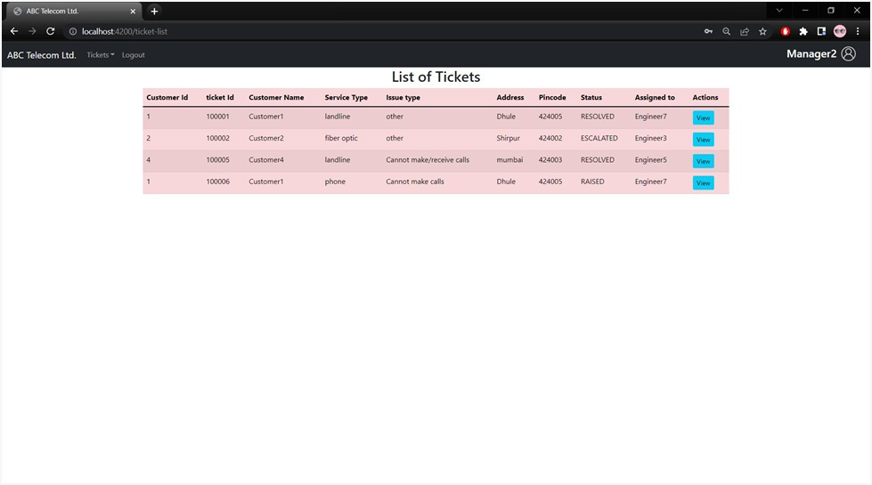
Manager can see the list of ticket and Assign to engineer

Slide 21

Engineer can see the list of ticket Assign to him by Manager

Slide 22
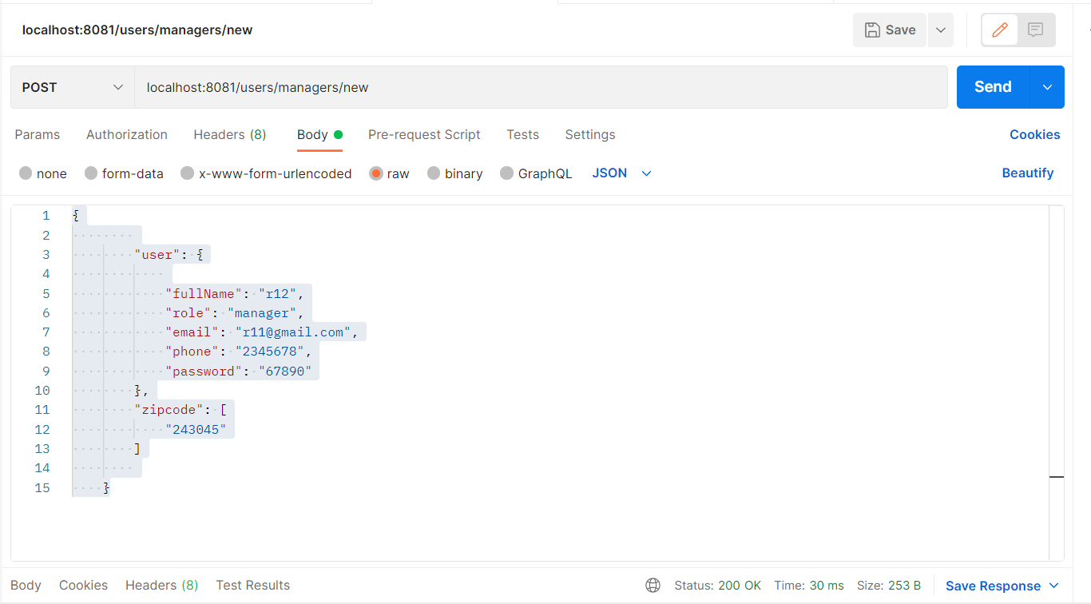
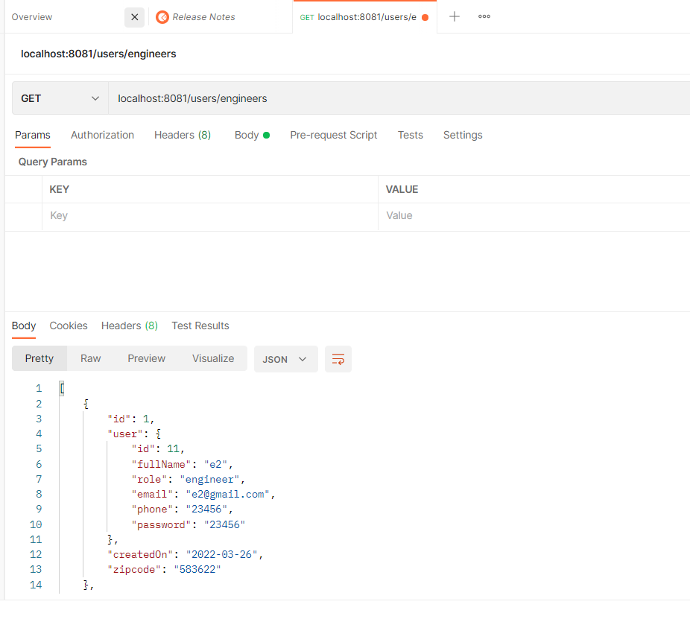
Postman Output

Slide 23
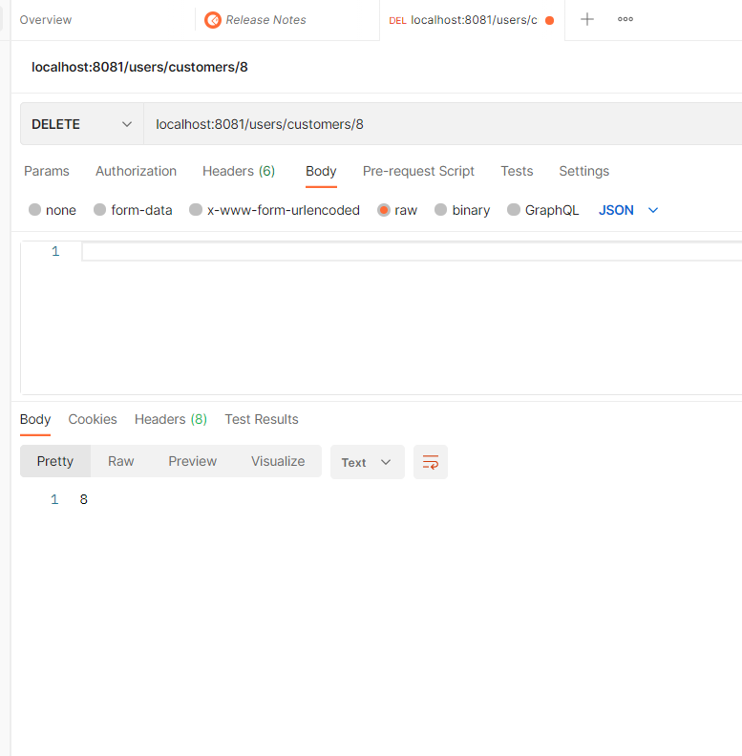

Slide 24
Conclusion
The admin can maintain a proper contact with their users, which may be access anywhere
All communications between the engineer and customer and administrator has done through the online.

Slide 25
Thank you

